Slide 1
CSE 465 Lecture 3-4
Deep Feed Forward Neural Networks

Slide 2
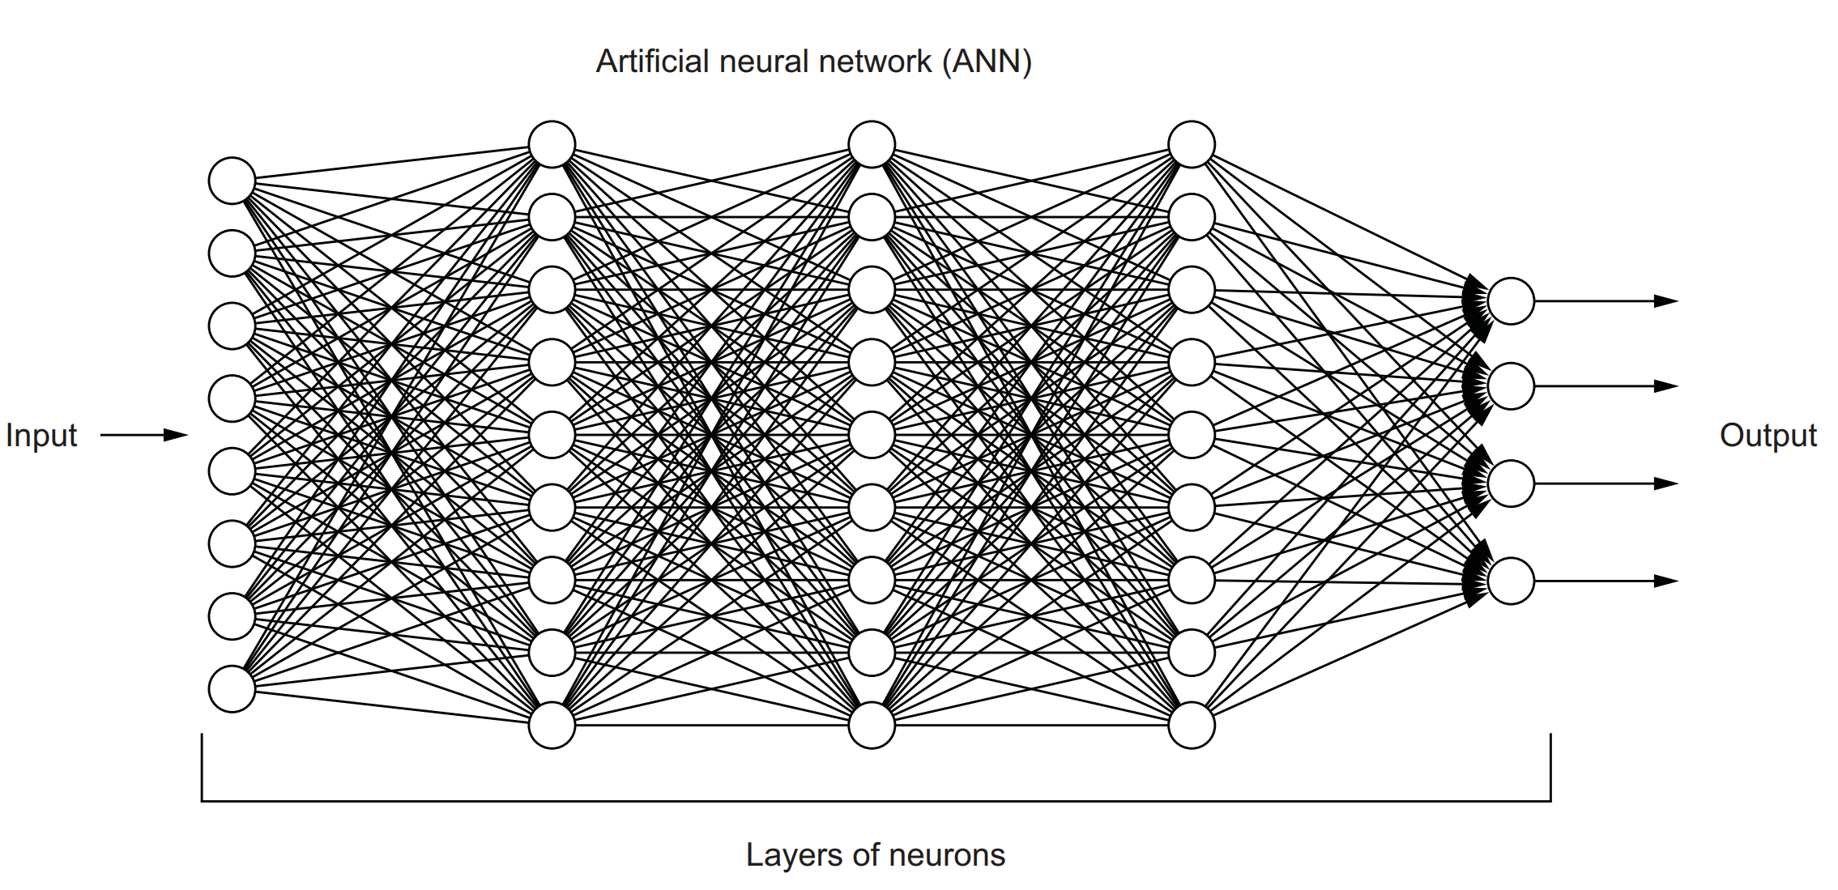
Artificial Neural Network (ANN)

Slide 3
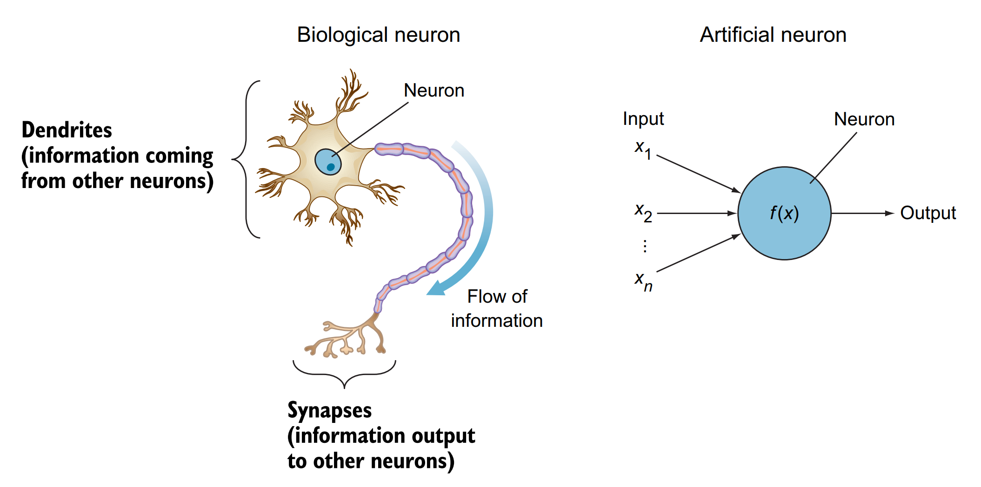
Perceptron
The most simple neural network is the perceptron, which consists of a single neuron
Conceptually, the perceptron functions in a manner similar to a biological neuron

Slide 4
Perceptron
The artificial neuron performs two consecutive functions
It calculates the weighted sum of the inputs to represent the total strength of the input signals
Then it applies a step function to the result
To determine whether to fire the output 1 if the signal exceeds a certain threshold or
0 if the signal doesn’t exceed the threshold
Not all input features are equally useful or important.
To represent that, each input node is assigned a weight value, called its connection weight, to reflect its importance

Slide 5
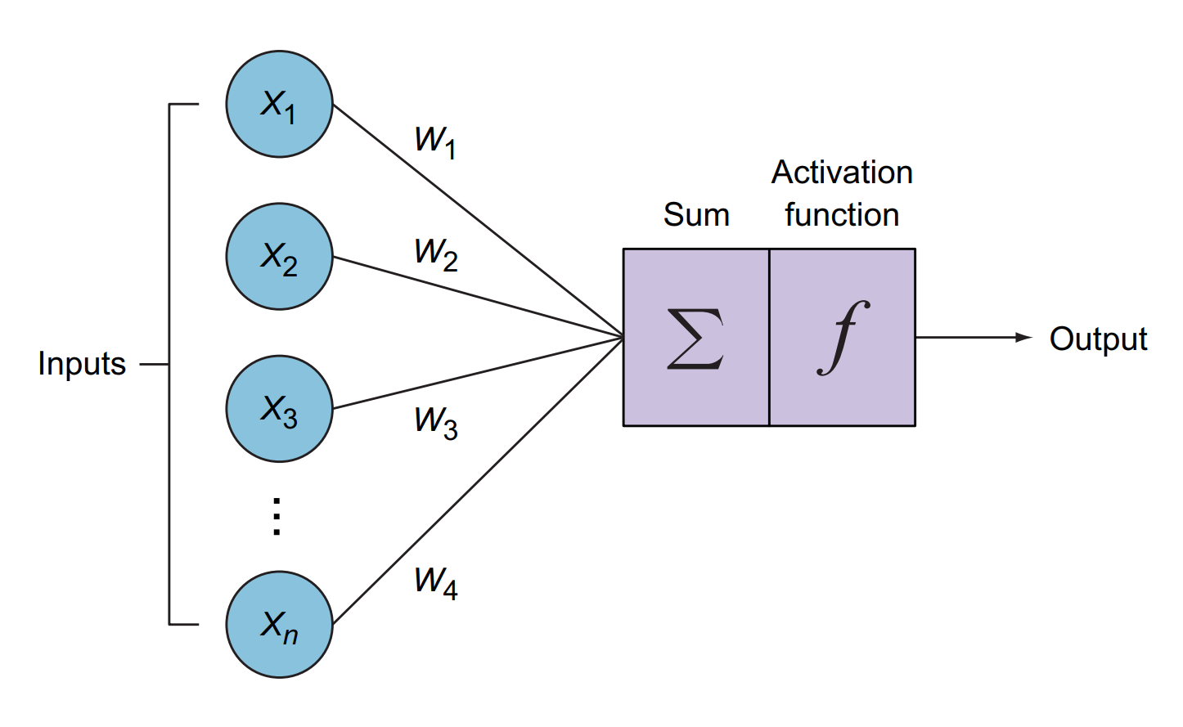
Perceptron
Input vector: The feature vector that is fed to the neuron
It is usually denoted with an uppercase X to represent a vector of inputs (x1, x2, . . ., xn)
Weights matrix: Each x_{i} is assigned a weight value w_{i}
Functions: The calculations performed within the neuron to modulate the input signals: the weighted sum and step activation function
Output: Controlled by the type of activation function

Slide 6
Weights matrix: Feature weights
Not all input features are equally important (or useful) features
Each input feature (x1) is assigned its own weight (w1) that reflects its importance in the decision-making process
Inputs assigned greater weight have a greater effect on the output
If the weight is high, it amplifies the input signal; and if the weight is low, it diminishes the input signal
In common representations of neural networks, the weights are represented by lines or edges from the input node to the perceptron

Slide 7
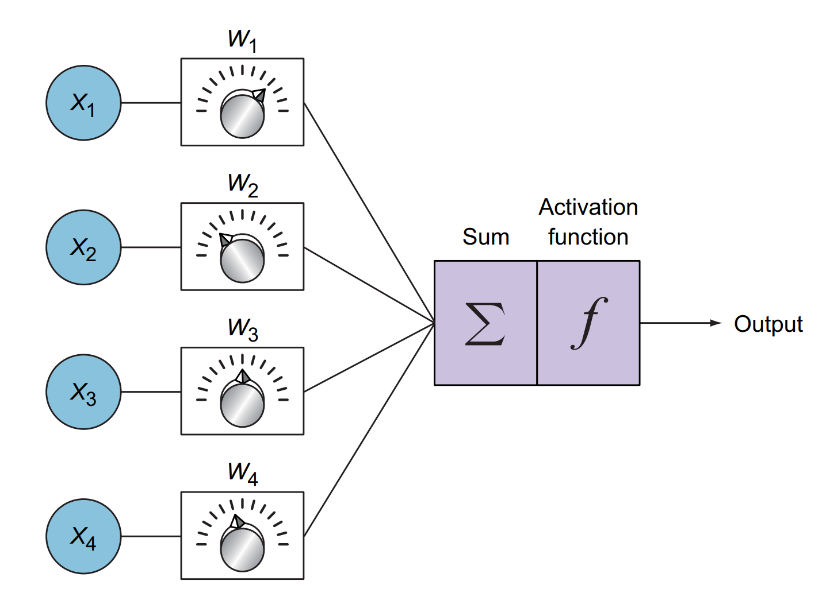
How does a perceptron learn?
The perceptron uses trial and error to learn from its mistakes
It uses the weights as knobs by tuning their values up and down until the network is trained
This process is repeated many times, and the neuron continues to update the weights to improve its predictions

Slide 8
Is one neuron enough?
Suppose we want to train a perceptron to predict whether a player will be accepted into the national Cricket squad
We collect all the data from previous years and train the perceptron to predict whether players will be accepted based on only two features (height and weight)
z = height · w₁ + age · w₂ + b
After the training is complete on the training data, we can start using the perceptron to predict with new players
When we get a player who is 150 cm in height and 12 years old, we compute the previous equation with the values (150, 12)
Here the single perceptron works fine because data was linearly separable

Slide 9
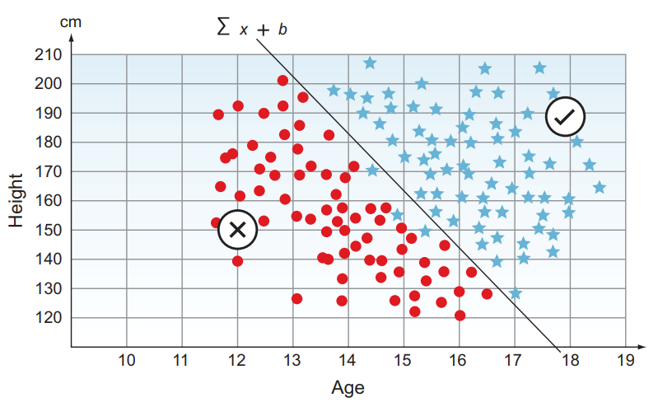
Model for accepting/rejecting players

Slide 10
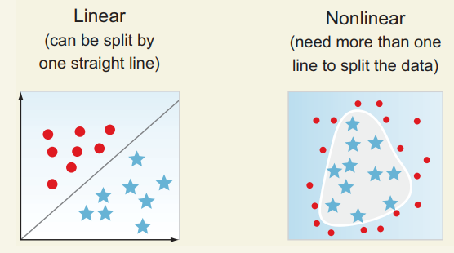
Linear/Nonlinear data
Linear datasets—The data can be split with a single straight line
Nonlinear datasets—The data cannot be split with a single straight line
We need more than one line to form a shape that splits the data
In the linear problem, the stars and dots can be easily classified by drawing a single straight line
In nonlinear data, a single line will not separate both shapes

Slide 11
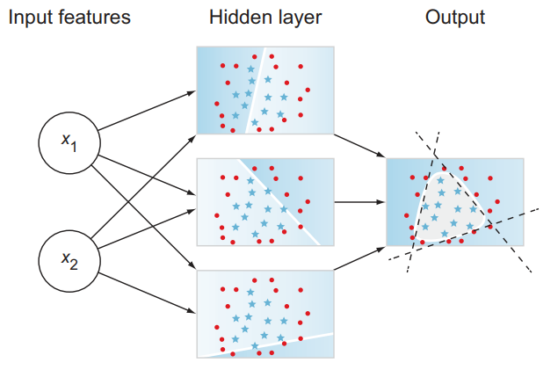
Multiple perceptron
To split a nonlinear dataset, we need more than one line
Example of a small neural network that is used to model nonlinear data
In this network, we used three neurons stacked together in one layer called a hidden layer, so called because we don’t see the output of these layers during the training process

Slide 12
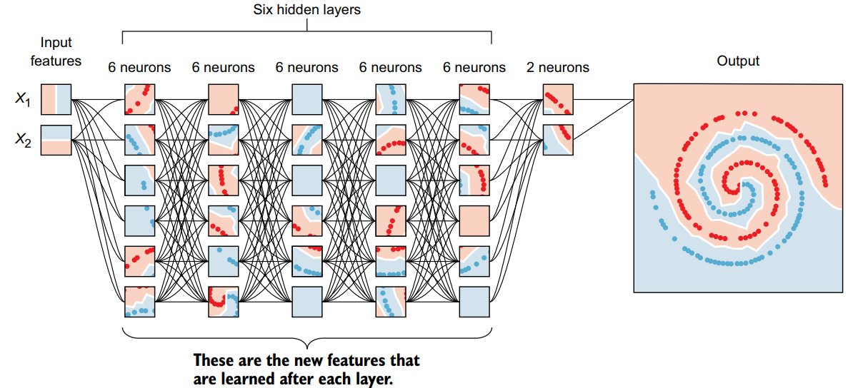
Multi-layer perceptron

Slide 13
Main components of a Neural Network
Input layer— Contains the feature vector
Hidden layers—The neurons are stacked on top of each other in hidden layers
They are called “hidden” layers because we don’t see or control the input going into these layers or the output
All we do is feed the feature vector to the input layer and see the output coming out of the output layer
Weight connections (edges)—Weights are assigned to each connection between the nodes to reflect the importance of their influence on the final output prediction
In graph network terms, these are called edges connecting the nodes
Output layer — We get the answer or prediction from our model from the output layer
Depending on the setup of the neural network, the final output
Could be a real-valued output (regression problem) or
A set of probabilities (classification problem)

Slide 14
Activation functions
Activation functions are sometimes referred to as transfer functions or nonlinearities because they transform the linear combination of a weighted sum into a nonlinear model
The purpose of the activation function is to introduce nonlinearity into the network
Without it, a multilayer perceptron will perform similarly to a single perceptron no matter how many layers we add
Activation functions are needed to restrict the output value to a certain finite value

Slide 15
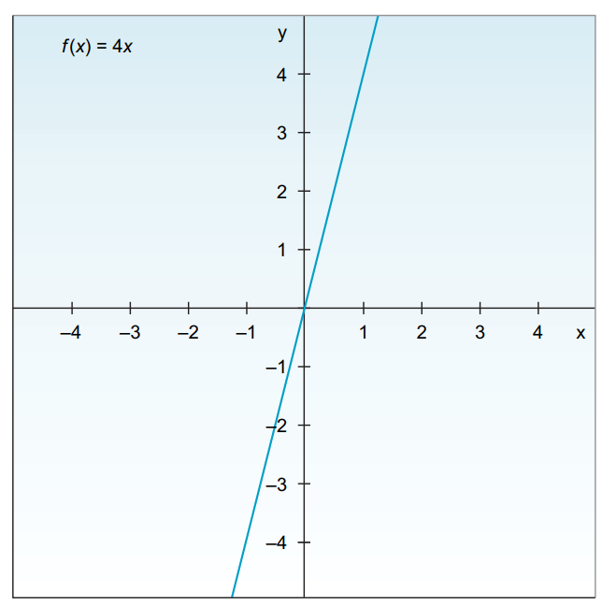
Linear Activation Function
A linear transfer function, also called an identity function, indicates that the function passes a signal through unchanged
In practical terms, the output will be equal to the input, which means we don’t actually have an activation function
So no matter how many layers our neural network has, all it is doing is computing a linear activation function or, at most, scaling the weighted average coming in

Slide 16
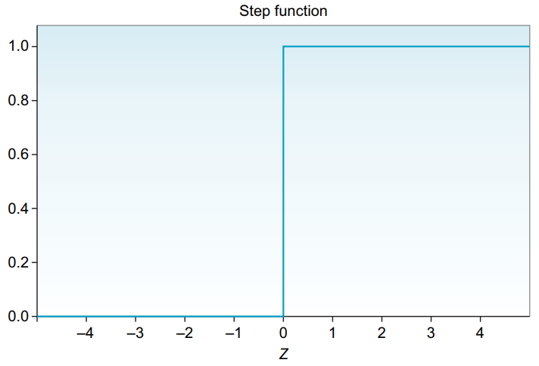
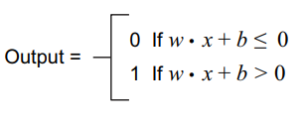
Step Activation Function
The step function produces a binary output
It basically says that
If the input x > 0, it fires (output y = 1)
Else (input < 0), it doesn’t fire (output y = 0)
It is mainly used in binary classification problems like true or false, spam or not spam, and pass or fail

Slide 17
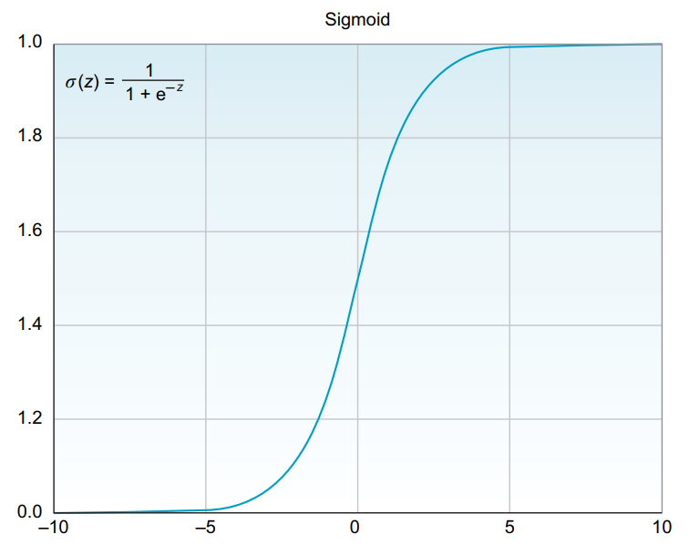
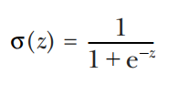
Sigmoid/Logistic Activation Function
This is one of the most common activation functions
It is often used in binary classifiers to predict the probability of a class when we have two classes
Sigmoid or logistic functions convert infinite continuous variables (range between –∞ to +∞) into simple probabilities between 0 and 1
It is also called the S-shape curve because when plotted in a graph, it produces an S-shaped curve.

Slide 18
Hyperbolic Tangent (tanh) Activation Function
The hyperbolic tangent function is a shifted version of the sigmoid version
Instead of squeezing the signal values between 0 and 1, tanh squishes all values to the range –1 to 1
Tanh almost always works better than the sigmoid function in hidden layers because it has the effect of centering your data so that the mean of the data is close to zero rather than 0.5, which makes learning for the next layer a little bit easier
One of the downsides of both sigmoid and tanh functions is that if (z) is very large or very small
Then the gradient (or derivative or slope) of this function becomes very small (close to zero), which will slow down gradient descent

Slide 19
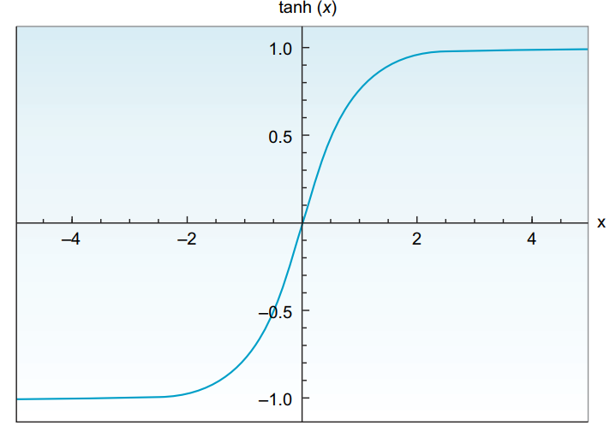

Hyperbolic Tangent (tanh) Activation Function

Slide 20
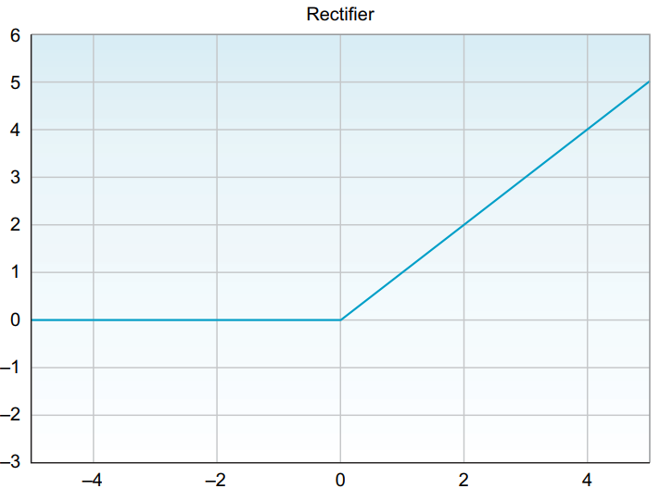
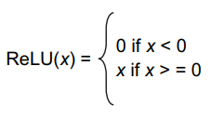
Rectified Linear (ReLU) Activation Function
The rectified linear unit (ReLU) activation function activates a node only if the input is above zero
If the input is below zero, the output is always zero
But when the input is higher than zero, it has a linear relationship with the output variable
ReLU is considered the state-of-the-art activation function because it works well in many different situations, and it tends to train better than sigmoid and tanh in hidden layers

Slide 21
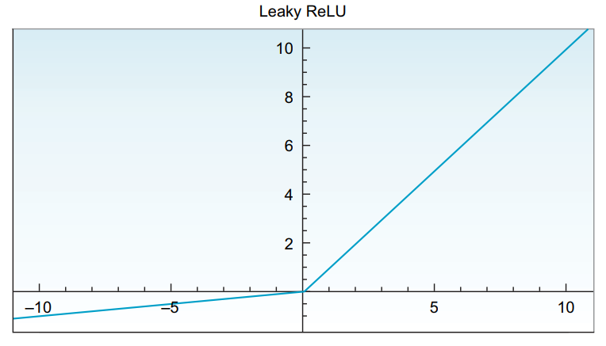
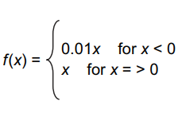
Leaky ReLU Activation Function
One disadvantage of ReLU activation is that the derivative is equal to zero when (x) is negative
Leaky ReLU is a ReLU variation that tries to mitigate this issue
Instead of having the function be zero when x < 0, leaky ReLU introduces a small negative slope (around 0.01) when (x) is negative
It usually works better than the ReLU function

Slide 22
Softmax Function
The softmax function is a generalization of the sigmoid function
It is used to obtain classification probabilities when we have more than two classes
It forces the outputs of a neural network to sum to 1 (for example, 0 < output < 1)
A very common use case in deep learning problems is to predict a single class out of many options (more than two)
Softmax is the go-to function that we often use at the output layer of a classifier when we are working on a problem where we need to predict a class between more than two classes
Softmax works fine classifying two classes, as well – it will basically work like a sigmoid function

Slide 23
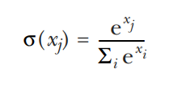
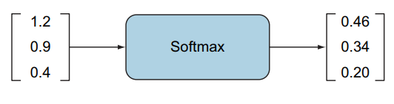
Softmax Activation Function (2)

Slide 24
The feedforward process
The term feedforward is used to imply the forward direction in which the information flows from the input layer through the hidden layers, all the way to the output layer
This process happens through the implementation of two consecutive functions
The weighted sum and
The activation function
In short, the forward pass is the calculations through the layers to make a prediction

Slide 25
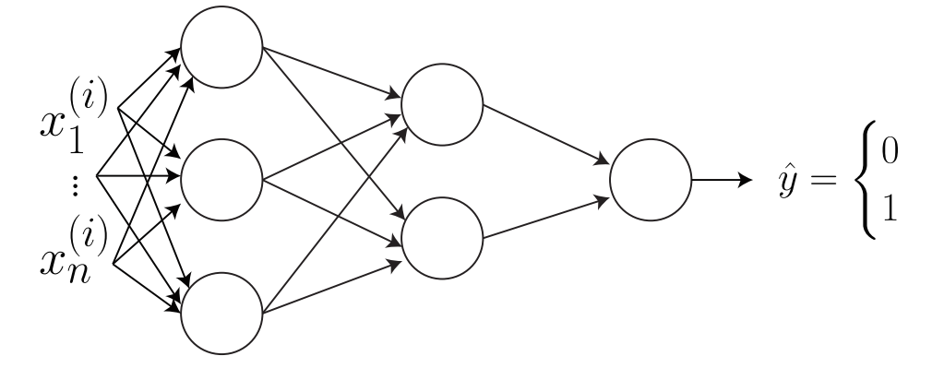
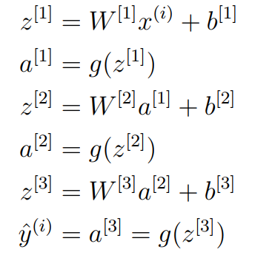
A fully connected Neural Network
Forward Calculation

Slide 26
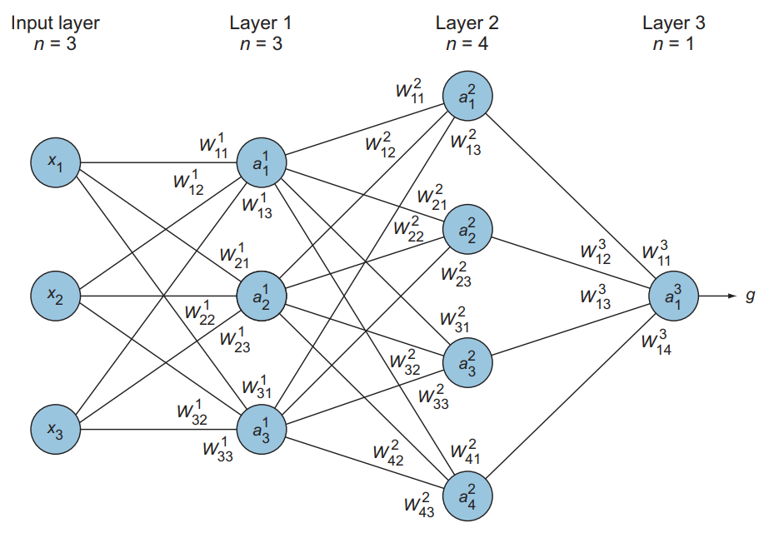
The weights break-down

Slide 27
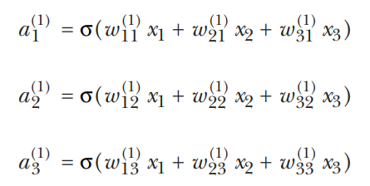


Feedforward calculation

Slide 28
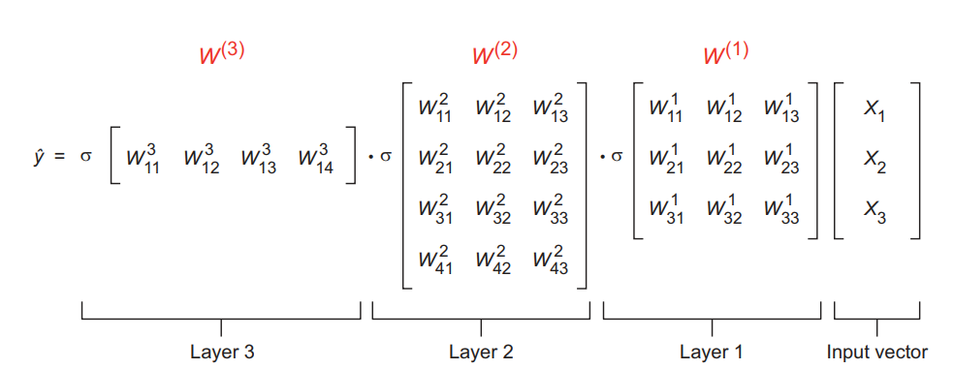
Feedforward process (2)

Slide 29
Feature learning
The nodes in the hidden layers (a_{i}) are the new features that are learned after each layer
For example, in the network of two slides earlier, we see that we have three feature inputs (x1, x2, and x3)
After computing the forward pass in the first layer, the network learns patterns, and these features are transformed to three new features with different values ( a₁¹, a₂¹, a₃¹)
Then, in the next layer, the network learns patterns within the patterns and produces new features (a₁², a₂², a₃² , and a₄², and so forth)
The produced features after each layer are not totally understood, and we don’t see them, nor do we have much control over them
That’s why they are called hidden layers
What we do is this: we look at the final output prediction and keep tuning some parameters until we are satisfied by the network’s performance

Slide 30
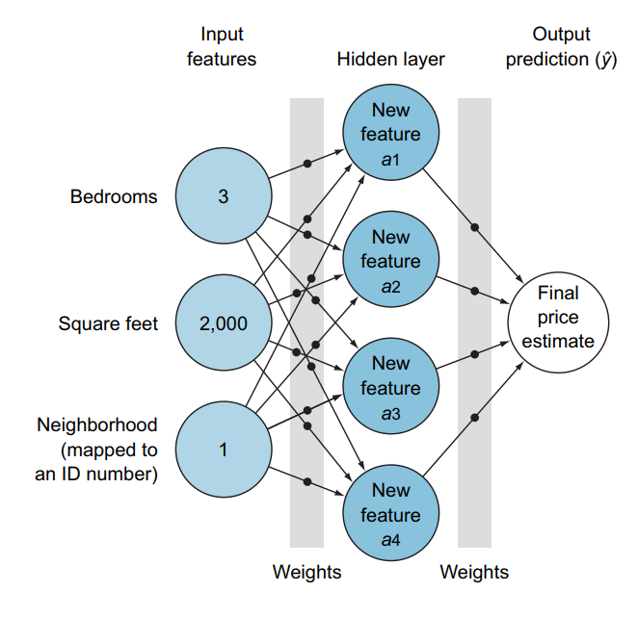
Feature Learning Process

Slide 31
Cost/Loss/Error Function
The error function is a measure of how “wrong” the neural network prediction is with respect to the expected output (the label)
It quantifies how far we are from the correct solution
For example, if we have a high loss, then our model is not doing a good job
The smaller the loss, the better the job the model is doing
The larger the loss, the more our model needs to be trained to increase its accuracy

Slide 32
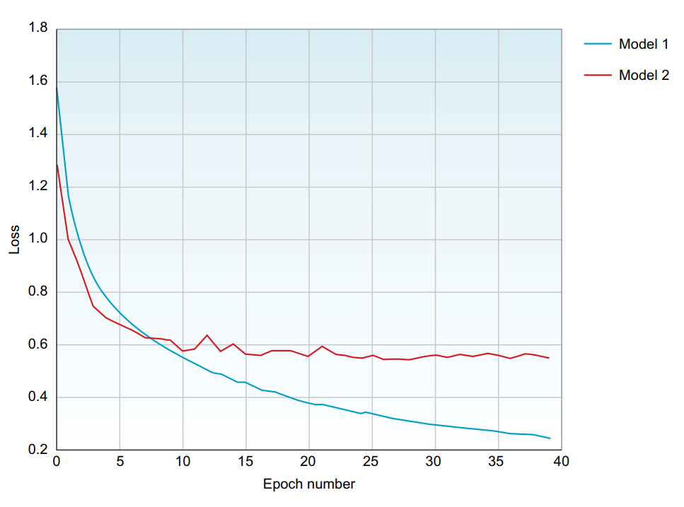
Loss Function to compare models

Slide 33


Mean Square Error Loss Function
Mean squared error (MSE) is commonly used in regression problems that require the output to be a real value (like house pricing)
Instead of just comparing the prediction output with the label (ŷ_{i} – y_{i}), the error is squared and averaged over the number of data points
MSE is a good choice for a few reasons
The square ensures the error is always positive, and
Larger errors are penalized more than smaller errors
MSE is quite sensitive to outliers, since it squares the error value
A variation error function of MSE called mean absolute error (MAE) is immune to this issue
It averages the absolute error over the entire dataset without taking the square of the error

Slide 34
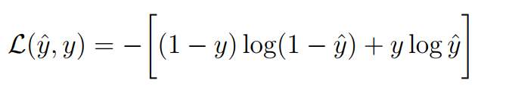
Cross-entropy loss function
The loss function L(ŷ; y) produces a single scalar value
Most common for Neural Networks
Cross-entropy is commonly used in classification problems because it quantifies the difference between two probability distributions
How close is the predicted distribution to the true distribution?
That is what the cross entropy loss function determines

Slide 35
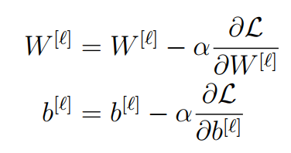
Training a neural network
Training a neural network involves showing the network many examples (a training dataset)
The network makes predictions through feedforward calculations and compares them with the correct labels to calculate the error
Finally, the neural network needs to adjust the weights (on all edges) until it gets the minimum error value, which means maximum accuracy
In neural networks, optimizing the error function means updating the weights and biases until we find the optimal weights, or the best values for the weights to produce the minimum error
In mathematical terms:

Slide 36
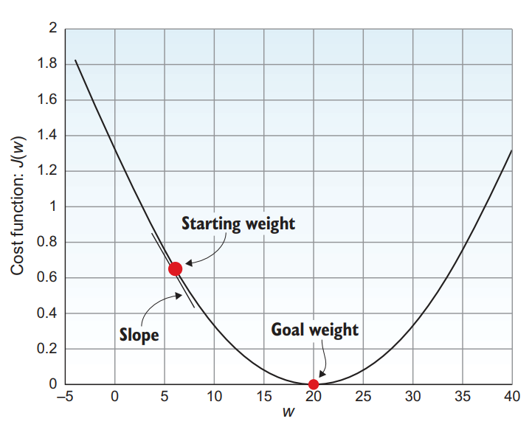
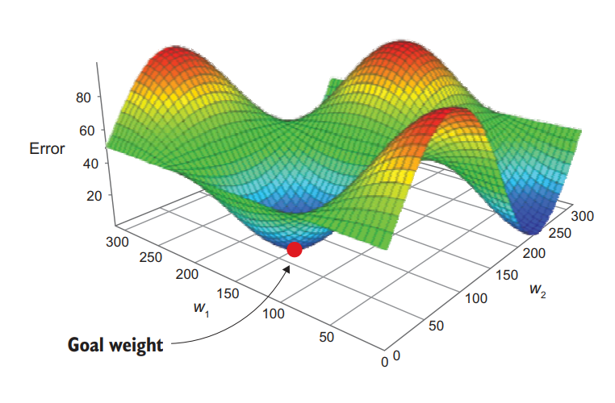
Optimizing the network: Cost function visualization

Slide 37
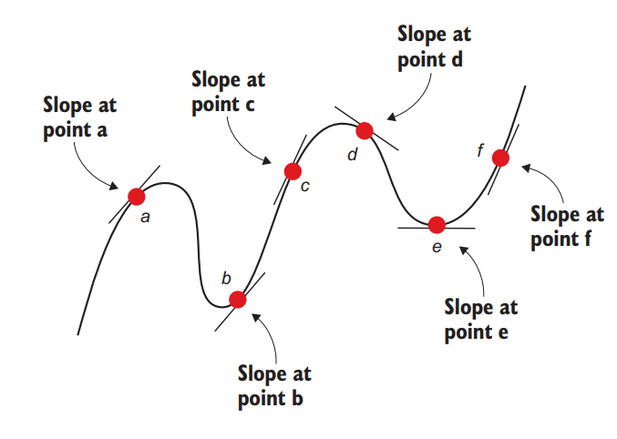
Optimization Algorithm: Gradient Descent
The general definition of a gradient (also known as a derivative) is that it is the function that tells the slope or rate of change of the line that is tangent to the curve at any given point
It is just a fancy term for the slope or steepness of the curve

Slide 38
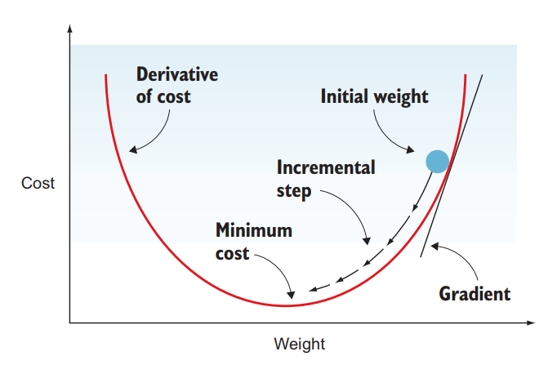
Gradient descent
Gradient descent simply means updating the weights iteratively to descend the slope of the error curve until we get to the point with minimum error
Gradient descent has several variations: batch gradient descent (BGD), stochastic gradient descent (SGD), and mini-batch GD (MB-GD)

Slide 39
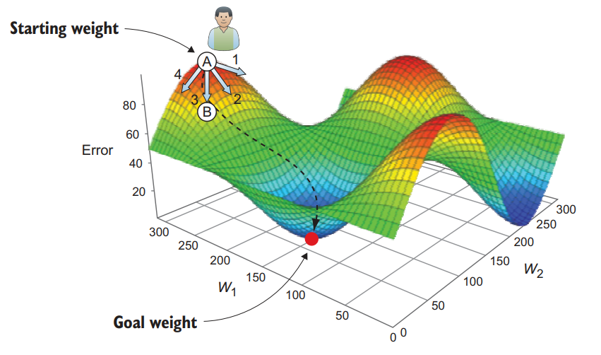
How does Gradient Descent work?
The random initial weight (starting weight) is at point A, and our goal is to descend this error mountain to the goal w1 and w2 weight values, which produce the minimum error value
The way we do that is by taking a series of steps down the curve until we get the minimum error
In order to descend the error mountain, we need to determine two things for each step
The step direction (gradient)
The step size (learning rate)

Slide 40
Stochastic/Mini-batch Gradient Descent
In stochastic gradient descent, we update the weights based on each data point at a time
This make the algorithm jump here and there and kind of unstable sometimes
However, end of the day, it provides better optimization
Mini-batch gradient descent is a compromise between Gradient Descent and stochastic GD
Instead of computing the gradient from one sample (SGD) or all samples (BGD), we divide the training sample into mini-batches from which to compute the gradient

Slide 41
GD vs SGD vs MBSGD
In practice, we use mini batch gradient descent (MBSGD) algorithm
The GD (also called BGD – batch gradient descent) almost always fails to find the optimal point (inherent in GD algorithm) and needs to load all data points to the memory before an update
The SGD is better in finding the optimal point than the GD, but is unstable
The MBSGD is the sweet point between GD and SGD: it updates the weight on small batches, so can use the memory optimally
Also better at finding the optimum than GD

Slide 42
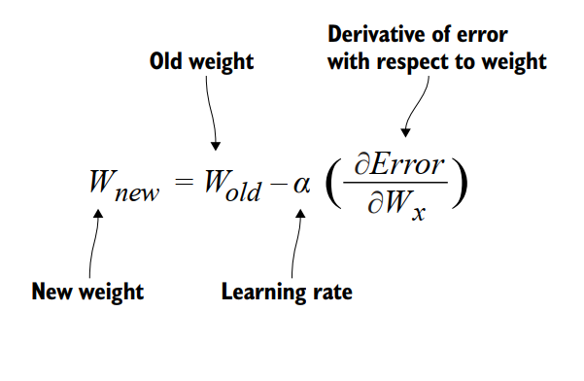
Backpropagation
Backpropagation is the core of how neural networks learn
Up until this point, we have learned that training a neural network typically happens by the repetition of the following three steps
Forward pass: get the linear combination (weighted sum), and apply the activation function to get the output prediction (ŷ)
Find the loss: Compare the prediction with the label to calculate the error or loss function
Update: Use a gradient descent optimization algorithm to compute the Δw that optimizes the error function

Slide 43

Initialize the W/b matrices
We cannot initialize all to 0
If we do that then z^{[3]} = W^{[3]}a^{[2]}+b^{[3]} will be 0
However, the output of the neural network is defined as a^{[3]} = g(z^{[3]})
Here g(·) is defined as the sigmoid function. This means a[3] = g(0) = 0.5. Thus, no matter what value of x(i) we provide, the network will output ŷ = 0.5
What if we had initialized all parameters to be the same non-zero value? In this case, consider the activations of the first layer
Each element of the activation vector a^{[1]} will be the same (because W^{[1]} contains all the same values)
This behavior will occur at all layers of the neural network

Slide 44
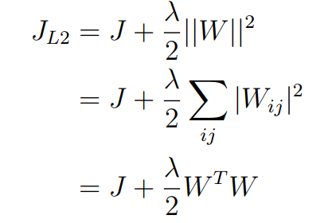
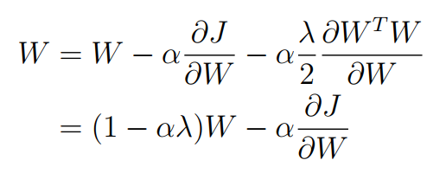
Regularization (more later)
Let W below denote all the parameters in a model. The L2 regularization adds another term to the cost function

